Slide 1
Coin Detection and Counting System
Dipali Pawar
Guide-
Dr. P. Roy

Slide 2
Abstract
Coin Detection Counting System is proposed,
To count the coins with accuracy.
Use IR Sensor to recognize coins.
To make a system which will be efficient for counting and sorting coins.
To detects the coin, then categorize/sorts according to the type count them also.
We also implement ‘Paper Vending Machine’ as application of the project.
Using this system students can easily get the assignment pages whenever they want.

Slide 3
Introduction
People use coins in their everyday lives.
Daily, banks produce and receive coins which they deliver to other establishments to supply their need for coins. Charitable institutions like temple gather coins from donations during mass. And in public transport sector, coins are widely used whether as fares or change.
Now day’s different types of vending machines also requires faster and accurate count of coins.
The design was developed to help the trade and industry in counting coins faster and easier. The sorting part of the design is mechanical as it sorts the coins through their physical size then counts them as they pass through the IR Sensors, this mechanism is faster and accurate.
A Microcontroller was used to determine the total number of coins, total amount per denomination and the total amount of all coins. A LCD (Liquid Crystal Display) is used to display the count.
After performing some tests with the Coin Sorting and Counting Machine, it is accurate and reliable machine.

Slide 4
EXISTING SYSTEM AND PROPOSED SYSTEM
Initial Proposed System
Initial proposed system was based on Image Processing Approach. In that, coin detection and counting was done using MATLAB and microcontroller was used for sorting of coins. As Image Based Approach was used, counting of bulk coins was not possible because Image Processing Approach can detect only one coin at a time.
Modified Proposed System
After literature survey, complexity of the project was realized by us using the Image Processing Approach. So, the project was modified by having Electro-Mechanical arrangement for detecting and sorting and counting by embedded system using Arduino UNO and the ATmega328P.

Slide 5
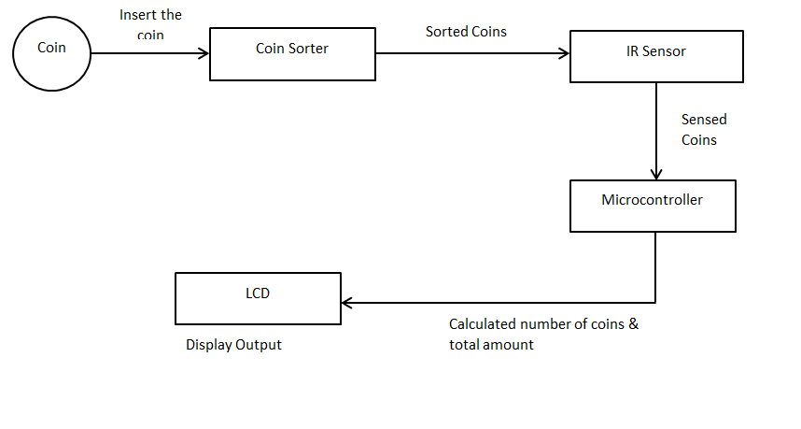
Block Diagram of CDCS

Slide 6
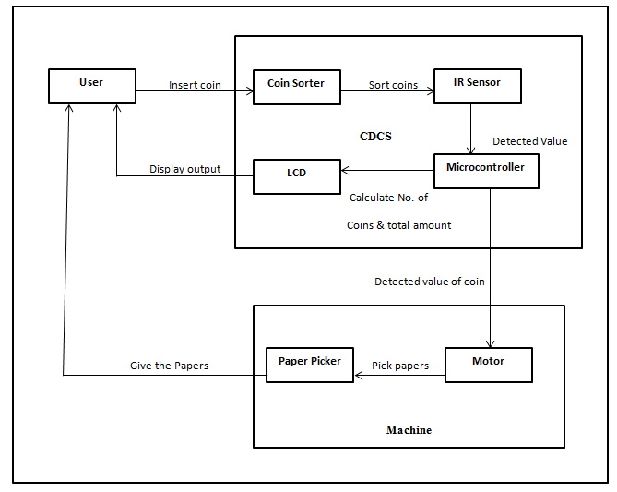
Block Diagram of Paper Vending Machine Based on CDCS

Slide 7
Working of CDCS
system starts after giving power supply to the prototype
LCD displays welcome message.
Then a coin is inserted into the system. Coin sensed by the IR sensor, count will be incremented of that particular coin and output will be displayed on LCD screen.
After that coin will be sorted in respective slot and Total amount will be displayed on LCD screen.

Slide 8
Working of Paper Vending Machine
Output of CDCS is act as input to vending machine
Before inserting a coin, toggle switch has to be switched in upward or downward direction to choose the printer.
Then a coin is inserted in CDCS, this coin is sensed by IR sensor and send signal to Arduino.
Arduino analyze the signal, identify which sensors gives it, according to that, arduino sends signal to LCD and LCD display the count and total amuont.
Simultaneously Arduino gives input signal to motor driver then motor driver drives the motor of any one of the two printers.
After that as per the inserted coin pages will be delivered to student.
One IR sensor is placed at the top of first printer and one IR sensor is placed at the top of second printer.
When the rack of paper is empty then, due to sensors attached on printer, buzzer will notify user that rack is empty.

Slide 9
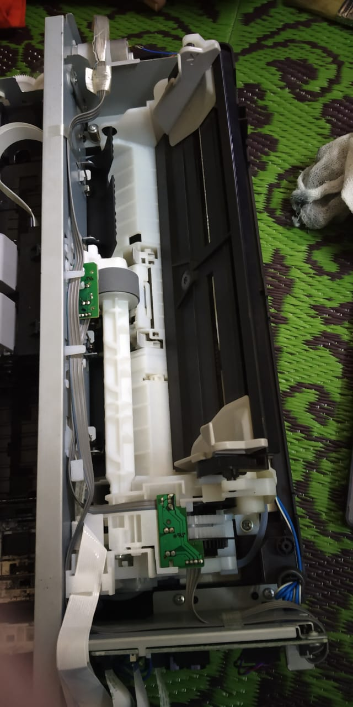
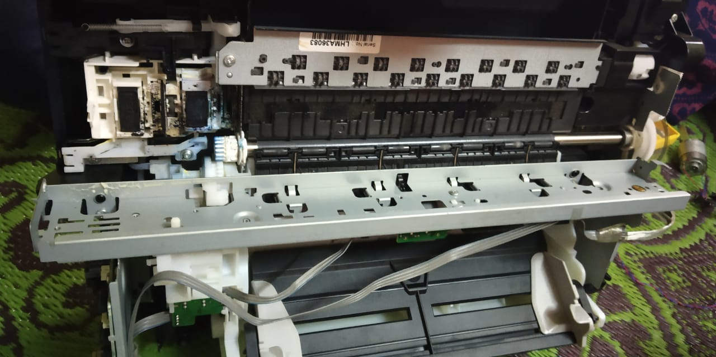
Experimentation And result

Slide 10
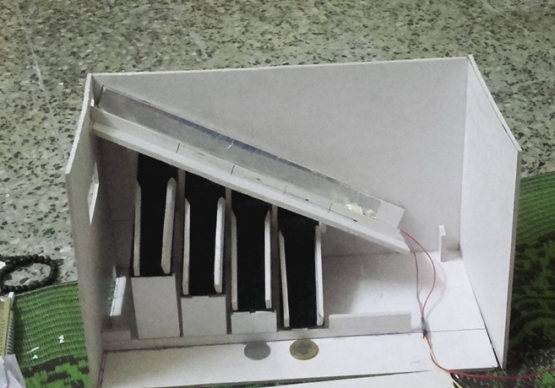
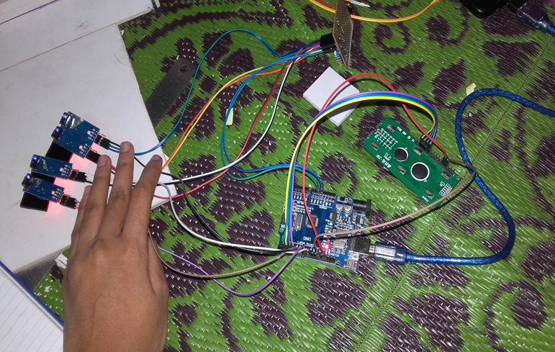
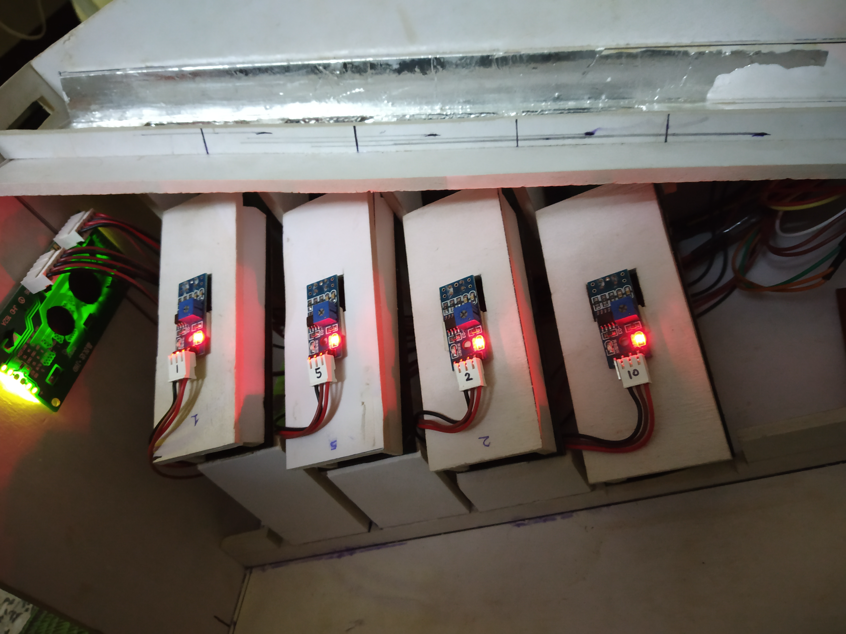
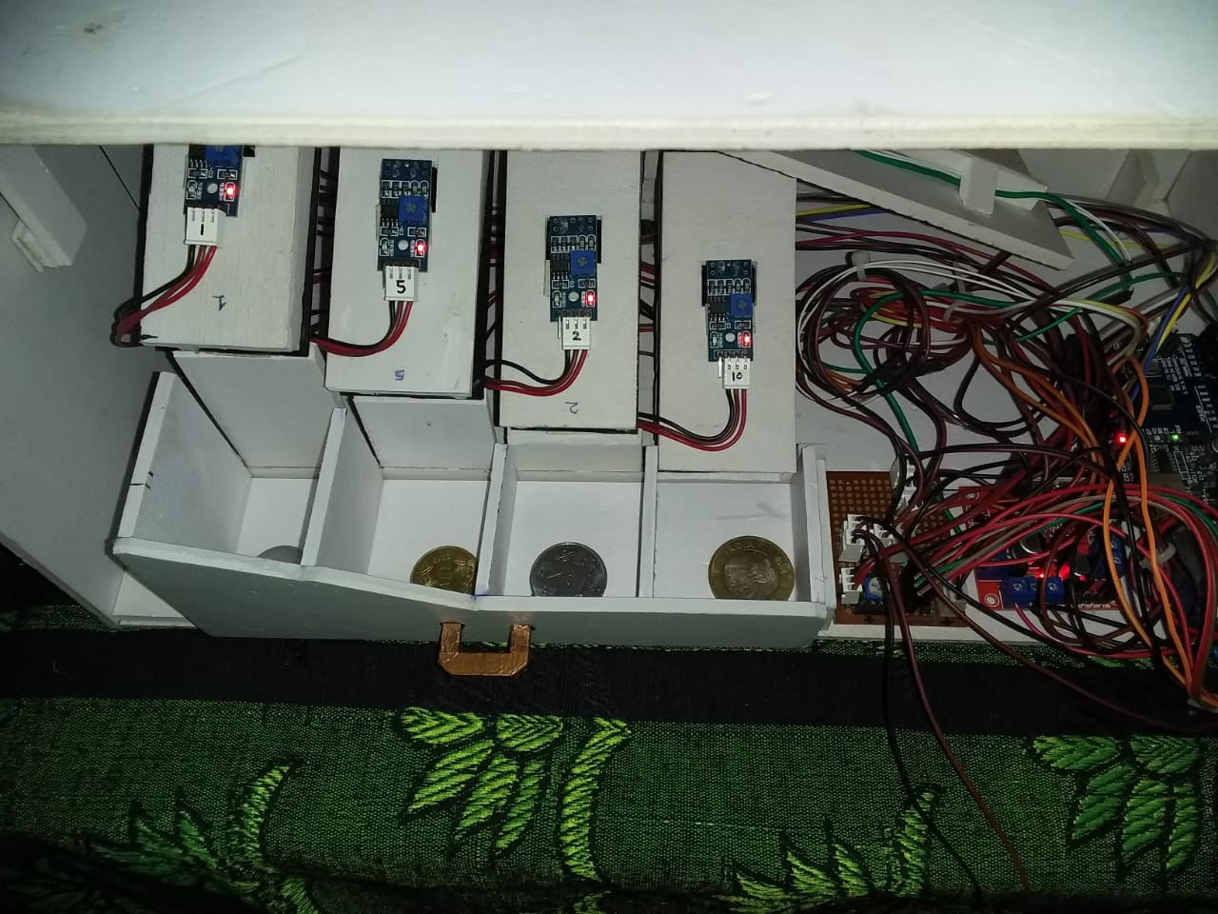
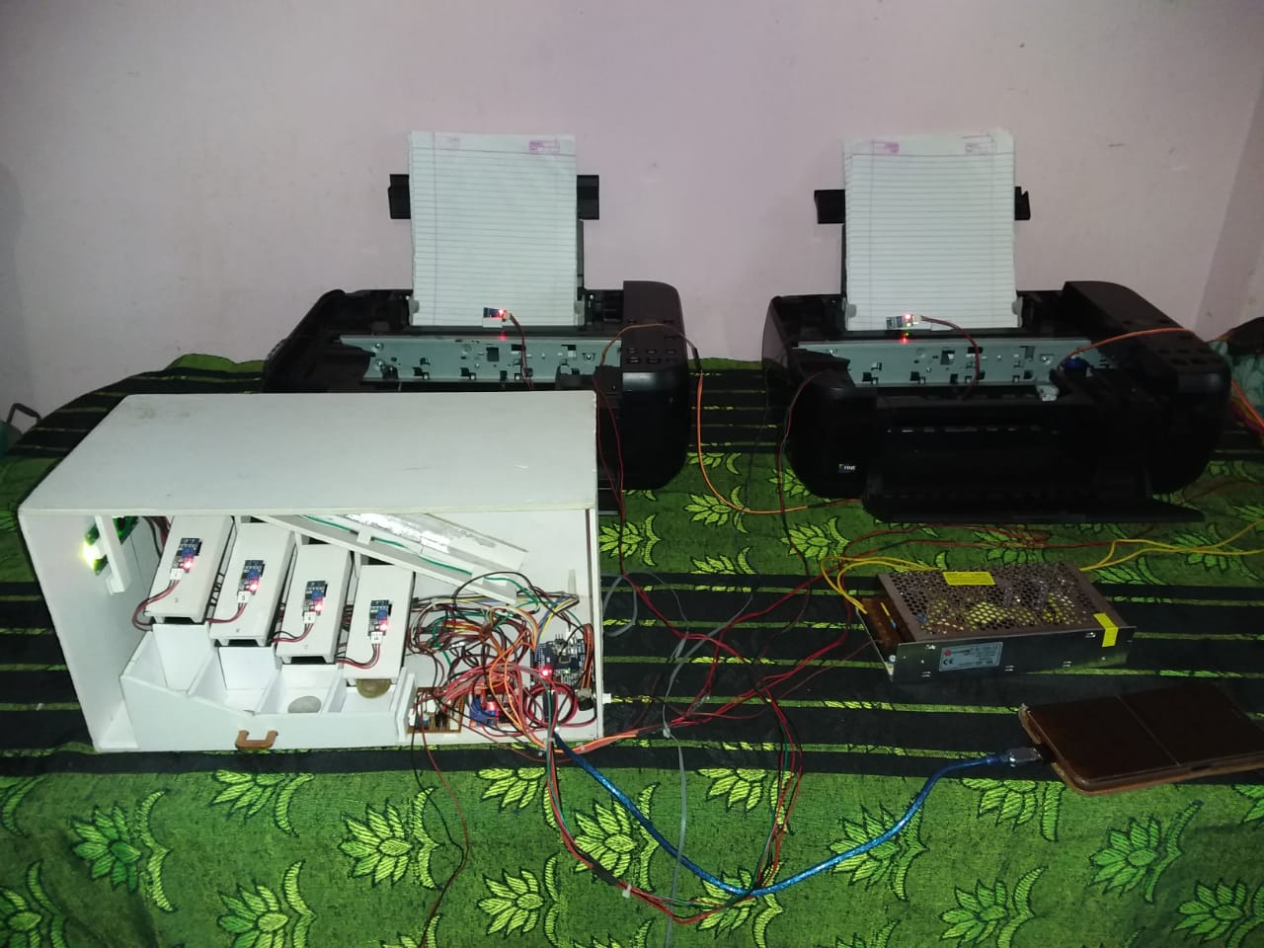
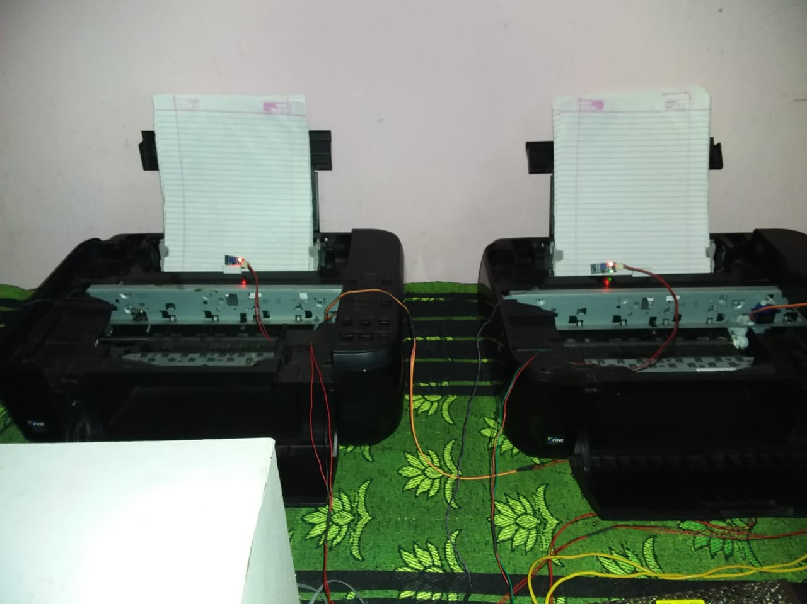

Slide 11
Conclusion
After performing a number of tests and trials on how the Coin Sorting and Counting Machine performed, it can be concluded that a nearly accurate and reliable system was created as proven by the results taken.
In the second phase of the project, an application based on CDCS is implemented successfully. The paper vending machine is working properly. Due to the use of printer’s mechanism the structure of machine is much simpler. Papers are easily come out from the system.
The goal of using CDCS in Automated paper vending machine is achieved successfully. The students can get the stationary papers at any time by just simply inserting coin into the system.

Slide 12
Thank you….

